Slide 1


<Pongpisut Kongdan>
<02-December-2022>

Slide 2

Outline
Executive Summary
Introduction
Methodology
Results
Conclusion
Appendix

Slide 3
Executive Summary
We create a prediction model for the SpaceX Falcon 9 first stage's successful or unsuccessful landing in this capstone project. If we are aware of whether the first stage will land, we can estimate the cost of a launch. To do this, various machine-learning categorization strategies will be employed.
Data collection, data wrangling and preprocessing, exploratory data analysis, data visualization, and machine learning prediction will all be part of the methodology used. The findings of our investigation and analysis suggest that there are some characteristics of rocket launches that are correlated with successful or unsuccessful launches.
The result shows that The Decision Tree may be the best machine-learning algorithm for this task.

Slide 4
Introduction
This capstone project's major objective is to foretell if the Falcon 9 first stage will successfully land. SpaceX advertises on their website that their rocket launches cost 62 million while other providers charge upwards of 165 million because they take great pride in being able to reuse the first stage of a rocket launch. The reuse of the first stage is largely responsible for these cost savings. The price of a launch can be calculated if we can know if the first stage will land. If a different business wants to compete with SpaceX for a rocket launch, it may use the information provided here.
This gets us to the main query we are attempting to address: For a specific set of characteristics of a Falcon 9 rocket launch to predict the landing outcomes

Slide 5

Section 1

Slide 6
Methodology
Data was gathered using two techniques: web scraping launch information from a Wikipedia article and requesting information from the SpaceX API. The data was then transformed and cleaned using the pandas module in Python.
Exploratory data analysis (EDA) was done on the clean data utilizing visualization tools including Python's matplotlib and seaborn packages, as well as SQL queries to provide answers. In order to respond to some analytical queries, interactive visualization packages in Python were employed. Maps were produced using Folium, and interactive data visualizations with Plotly Dash. Perform interactive visual analytics using Folium and Plotly Dash
For the prediction study, four alternative machine learning classification models were employed. The models utilized were decision tree classifier, logistic regression, support vector machines, and k-nearest neighbor. To choose the best model, each one was trained, adjusted, and tested, using suitable evaluators.

Slide 7
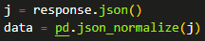
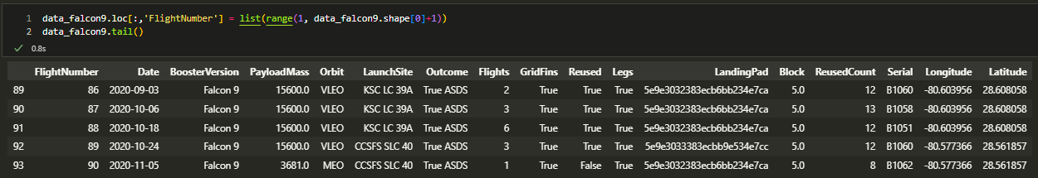
Data Collection – SpaceX API
SpaceX API
1. Request and parse SpaceX laugh data using request.get
2. Normalize JSON to data frame using panda.json_normalize
3. Take a subset of the data frame keeping only useful features
4. Filter data frame to include only Falcon 9 launches
5. Handling missing values
GitHub Link (Ctrl + Click): Data Collection

Slide 8
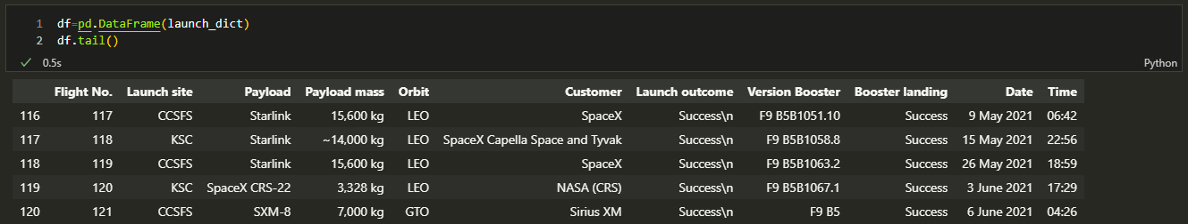
Data Collection - Scraping
Calculate the number of launches on each site
Calculate the number and occurrence of each orbit
Calculate the number and occurrence of mission outcome per orbit type
Create a landing outcome label from Outcome column
GitHub Link (Ctrl + Click): Data Collection Scraping

Slide 9
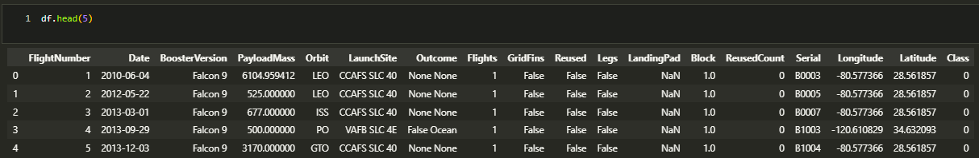
Data Wrangling
Calculate the number of launches on each site
Calculate the number and occurrence of each orbit
Calculate the number and occurrence of mission outcome per orbit type
Create a landing outcome label from Outcome column
GitHub Link (Ctrl + Click): Data Wrangling

Slide 10
EDA with Data Visualization
Scatter plots were used to show how two variables related to one another. There were comparisons between various feature sets, including Flight Number vs. Launch Site, Payload vs. Launch Site, Flight Number vs. Orbit Type, and Payload vs. Orbit Type.
By using bar charts, it is simple to quickly compare numbers between several groupings. A discrete value is represented by the y-axis, while a category is represented by the x-axis. To compare the Success Rate for various Orbit Types, bar charts were employed.
A line chart was employed. For displaying data trends across time, line charts are helpful. To display the success rate over a certain number of years.
GitHub Link (Ctrl + Click): EDA with Viz

Slide 11
EDA with SQL
The following is a list of some of the SQL queries that were run on the dataset:naming the distinct launch sites in the space mission and displaying their names displaying 5 entries for launch sites where the first letter is "CCA"showing the total payload weight carried by NASA-launched rockets (CRS) showing the average payload weight carried by booster F9 v1.1
The names of the boosters with successful landing outcomes in drone ships and payload masses greater than 4000 but less than 6000, the total number of successful and unsuccessful mission outcomes, the names of the booster versions that carried the maximum payload mass, the failed landing outcomes in drone ships, their booster versions, and the launch site na decreasing order of the number of landing outcomes between 2010-06-04 and 2017-03-20.
GitHub Link (Ctrl + Click): EDA with SQL

Slide 12
Build an Interactive Map with Folium
A Folium map was updated with new objects. All launch sites and successful/failed launches for each site were shown on a map using marker objects. The distances between a launch location and its close by features, such as the coastline, railroads, highways, and cities, were calculated using line objects.
GitHub Link (Ctrl + Click): Map with Folium
*** If you can not see the folium map, please download the file and run it on your local machine. This problem is probably due to the execution of Javascript is being blocked for some reason, try changing browsers might solve the problem.

Slide 13
Build a Dashboard with Plotly Dash
A pie chart displaying each site's successful launch. This graph is helpful since it allows you to display the success rate of launches on specific sites or visualize the distribution of landing
A scatter diagram illustrating the relationship between landing success and the mass of various boosters. The site(s) and payload mass are the dashboard's two inputs. This chart is helpful since it allows you to see how different factors influence the results of the landing.
GitHub Link (Ctrl + Click): Dash

Slide 14
Predictive Analysis (Classification)
Create a NumPy array from the column ‘Class’ as ‘Y’
Standardizing the features ‘X’
Split data into training and test set
Create the Logistic regression model, perform prediction, and evaluate the model
Create the SVM model, perform prediction, and evaluate the model
Create the Decision Trees model, perform prediction, and evaluate the model
Create the K-Nearest Neighbours model, perform prediction, and evaluate the model
Compare All models based on their accuracy scores and confusion matrix
GitHub Link (Ctrl + Click): Predictive Analysis

Slide 15
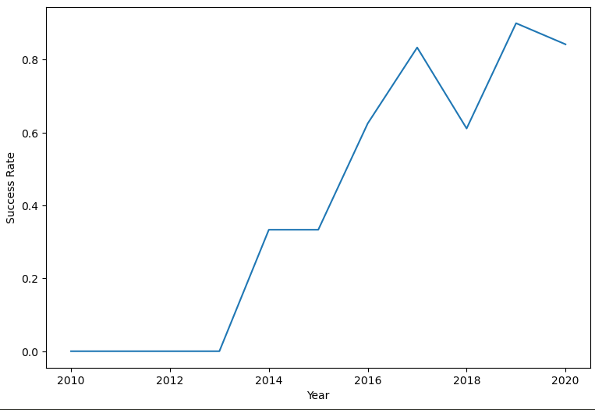
Results: Exploratory Analysis
According to the findings of the exploratory data analysis, the success percentage of the Falcon 9 landings was 66.66%, and it increased over the years.

Slide 16
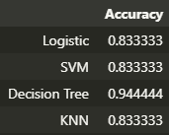
Results: Predictive Analysis
According to the results of the predictive analysis, the Decision Tree algorithm was the best classification technique, which had a 94% accuracy rate,

Slide 17
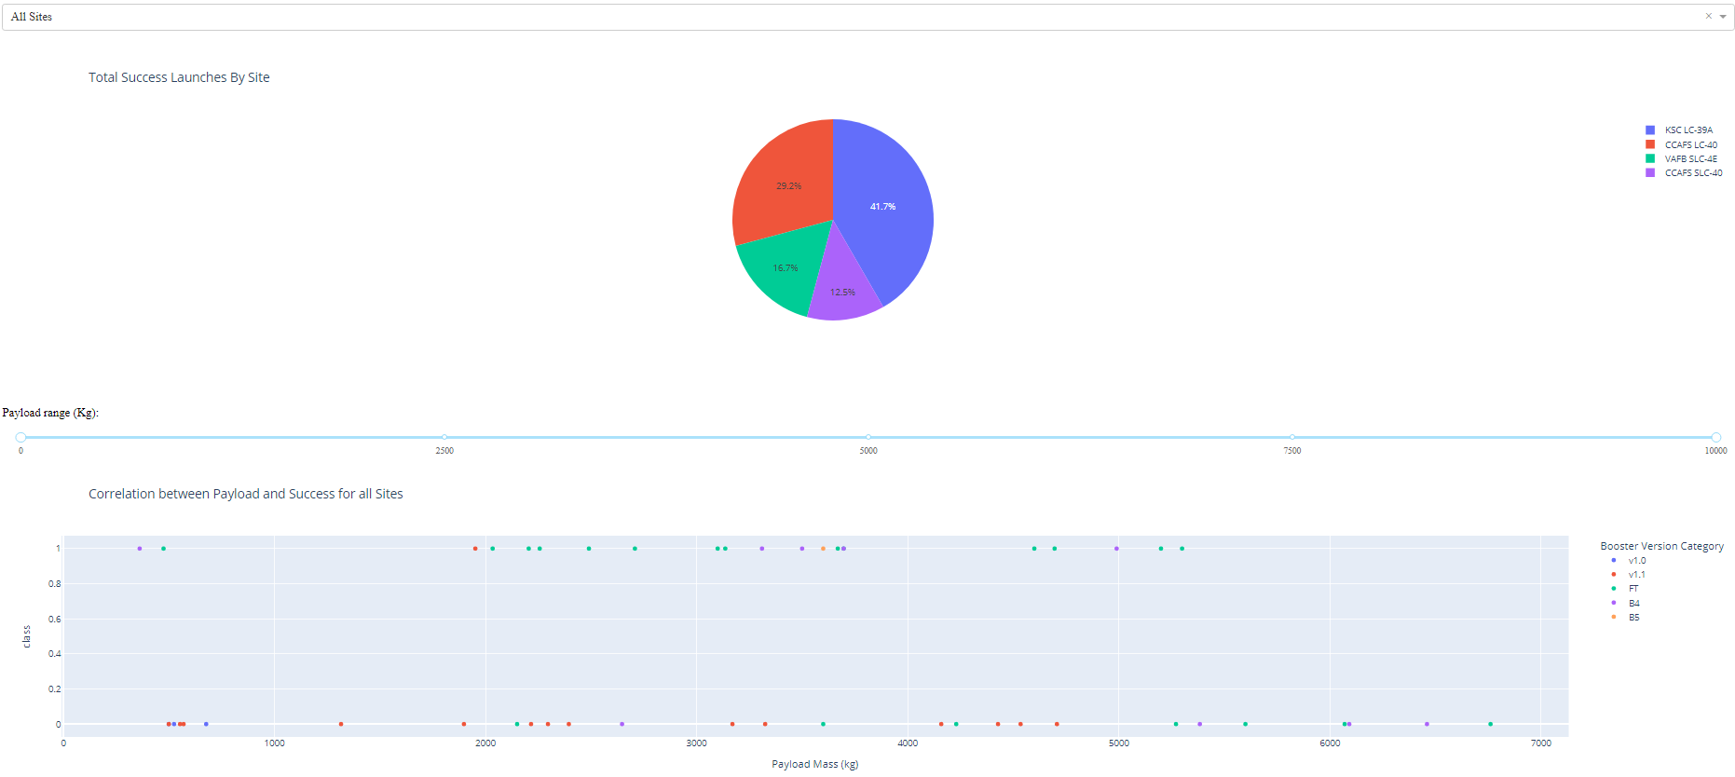
Results: SpaceX Launch Records Dashboard

Slide 18

Section 2

Slide 19
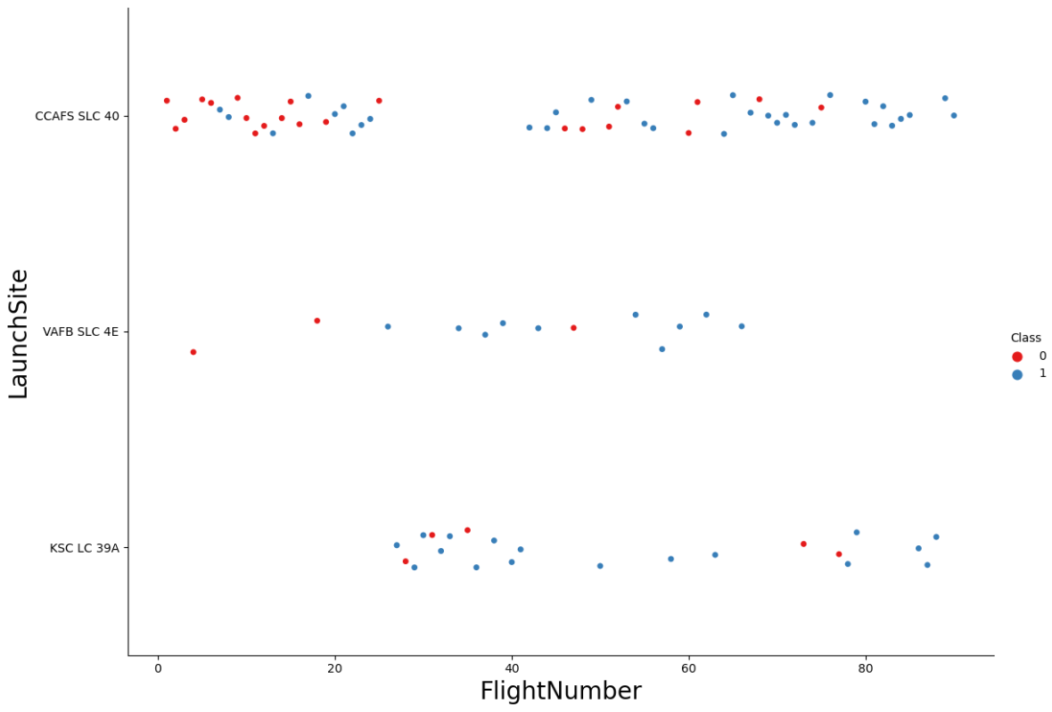
Flight Number vs. Launch Site
The successful launches are shown by blue dots, whereas the failed launches are represented by red dots.
This graph demonstrates that as the number of flights increased, so did the success rate.
As the number of flights increases, so does the success rate.

Slide 20
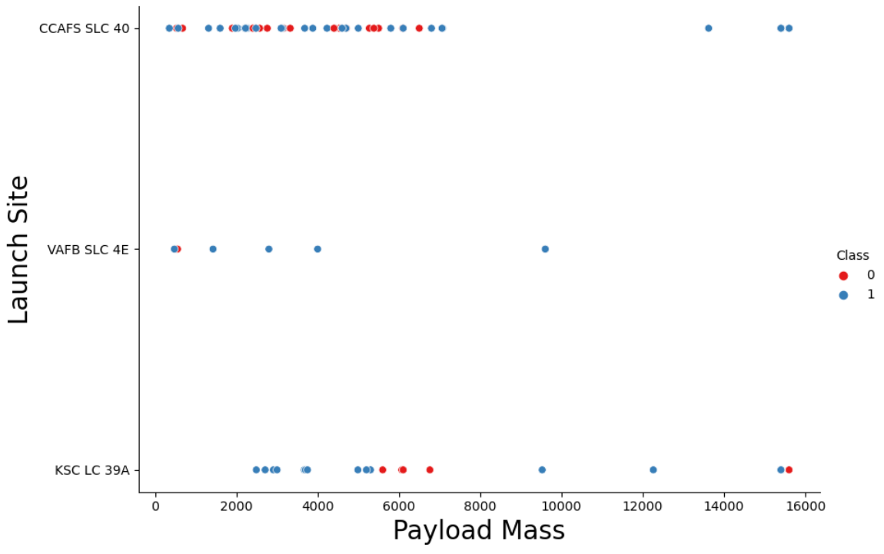
Payload vs. Launch Site
The successful launches are shown by blue dots, whereas the failed launches are represented by red dots.
There are no rockets launched for heavy payload mass from the VAFB-SLC launch site.
Decisions cannot be made using this metric because there appears to be a poor association between Payload and Launch Site.

Slide 21
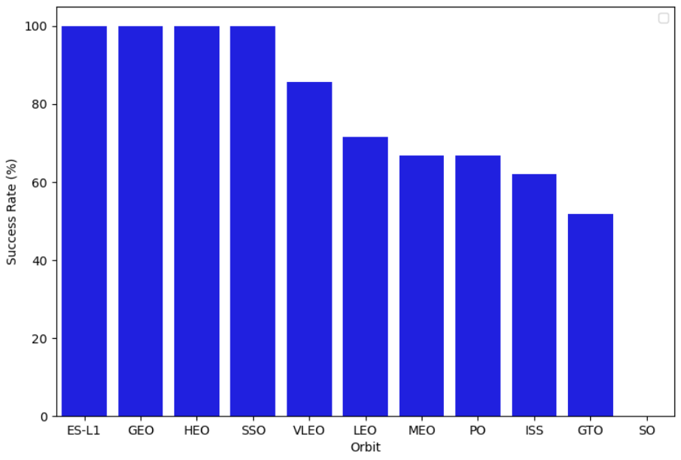
Success Rate vs. Orbit Type
The launch of SSO, HEO, GEO, and ES-L1 orbits has never failed.
No rockets from SO orbit were successful.

Slide 22
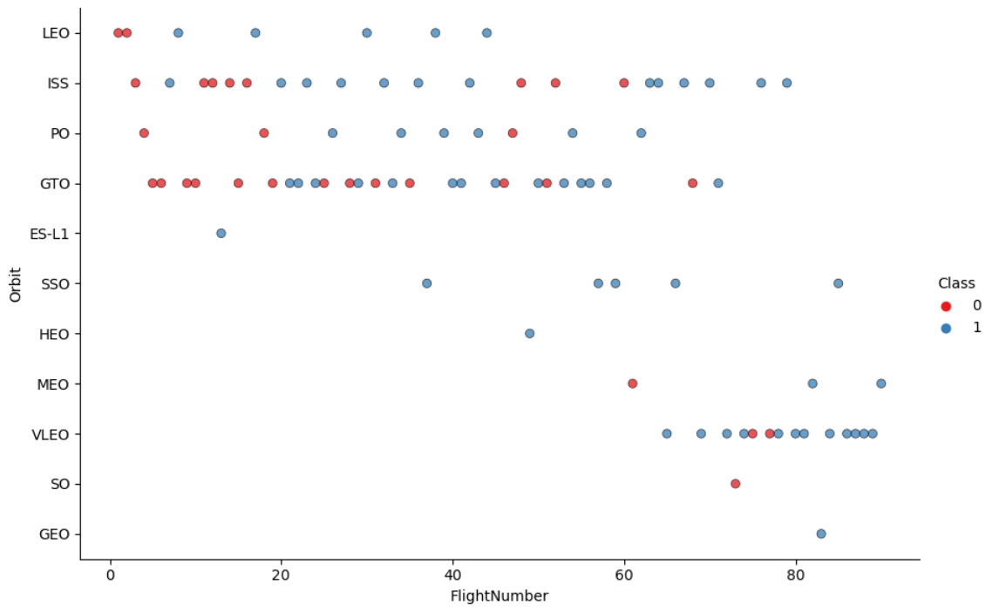
Flight Number vs. Orbit Type
In the GTO orbit, there doesn't appear to be a correlation between flight numbers.
In most of the Orbit, the number of flights is positively connected with success.
Flights with numbers over 40 have a higher success percentage than flights with numbers ranging from 0 to 40.
Despite having fewer flights than the other orbits, the SSO orbit has a success rate of 100%.

Slide 23
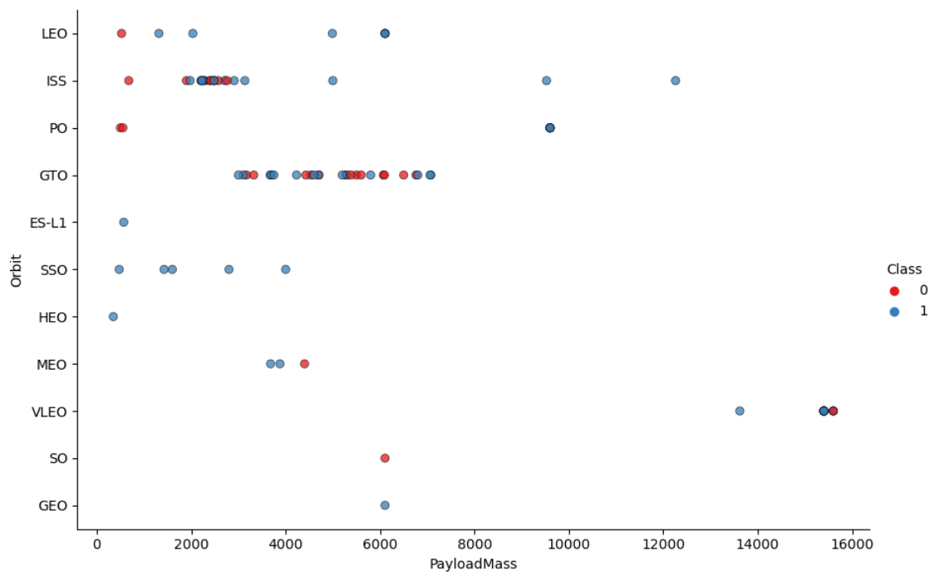
Payload vs. Orbit Type
Given that both successful and unsuccessful launches are frequently observed, there does not appear to be a direct association between orbit type and payload mass for GTO orbit.
As payload weight grows, most orbits' success rates increase, however, there is one outlier that failed in VLEO orbit.

Slide 24
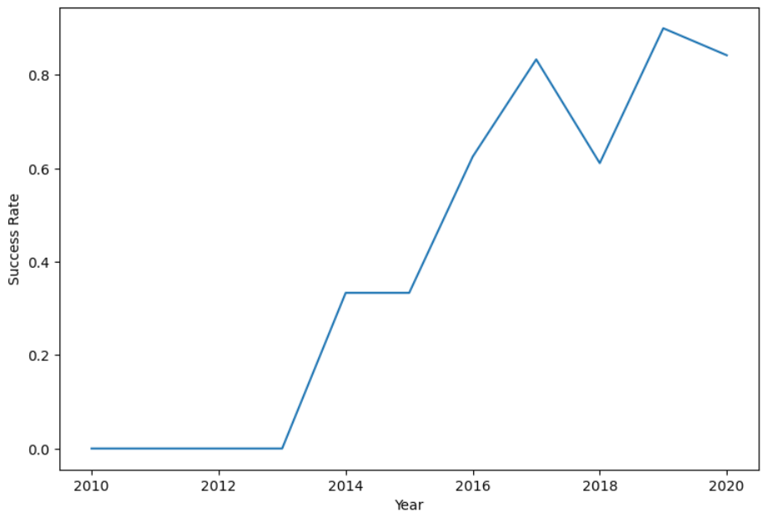
Launch Success Yearly Trend
As the years go by, the chart's overall trend indicates an increase in landing success rate. However, there is a decline in both 2018 and 2020, and more research must be done to determine the reason for the decline.

Slide 25
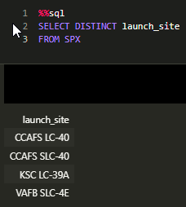
All Launch Site Names
The DISTINCT clause was used to retrieve the distinct rows from the launch site column. The distinct launch sites are identified as follows:
CCAFS LC-40
CCAFS SLC-40
KSC LC-39A
VAFB SLC-4E

Slide 26
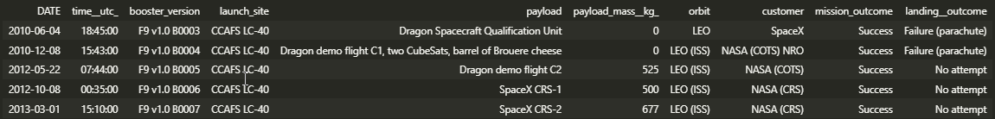
Launch Site Names Begin with 'CCA'
We select all the columns from the database, then specify where the launch site starts with CCA, then limit the record to 5.

Slide 27
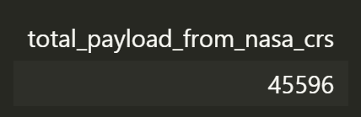
Total Payload Mass
We use SUM() function to calculate to total payload carried by boosters launched by NASA (CRS)

Slide 28
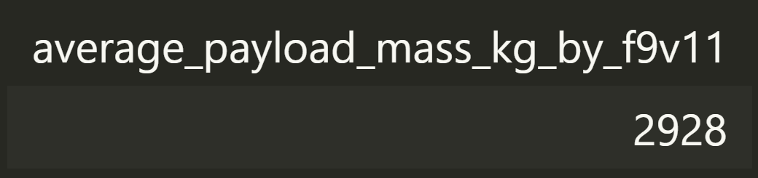
Average Payload Mass by F9 v1.1
We use AVG() function to calculate the average payload mass carried by booster version F9 v1.1, which specified by WHERE statement.

Slide 29
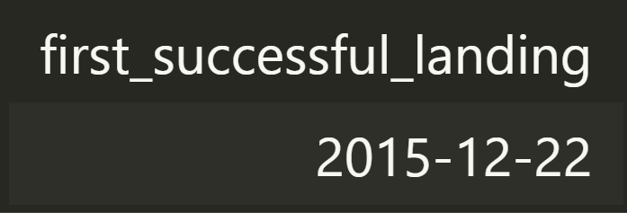
First Successful Ground Landing Date
We use MIN() function to find the first successful ground landing, then we use WHERE statement to filter only the landing which landed on the ground pad.

Slide 30
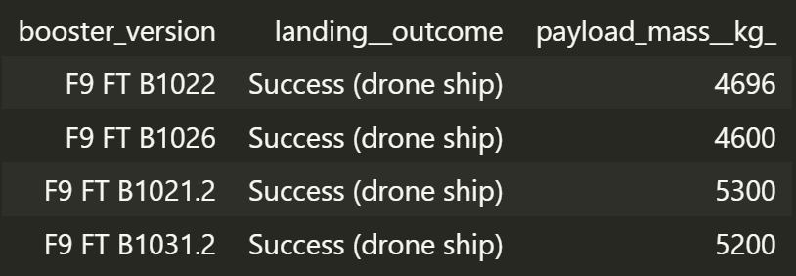
Successful Drone Ship Landing with Payload between 4000 and 6000
We select the Successful Drone Ship Landing with a Payload between 4000 and 6000 by using AND operator in WHERE statement:
payload_mass__kg_ > 4000
landing__outcome = 'Success (drone ship)’
payload_mass__kg_ < 6000
Alternatively, you can use BETWEEN clause combined with WHERE statement.

Slide 31
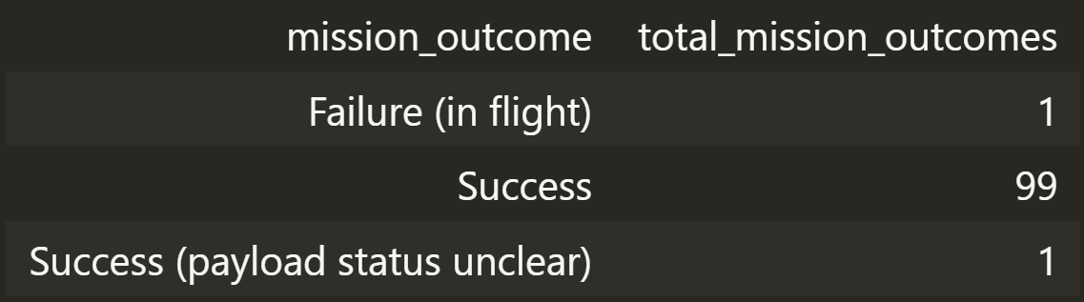
Total Number of Successful and Failure Mission Outcomes
We use COUNT() function to count the number of mission outcomes, and then we grouped them by mission outcome in GROUP BY statement.
There are 100 successful mission outcomes, with 1 mission having the status ‘payload status unclear'. Total missions of 101 were conducted.

Slide 32
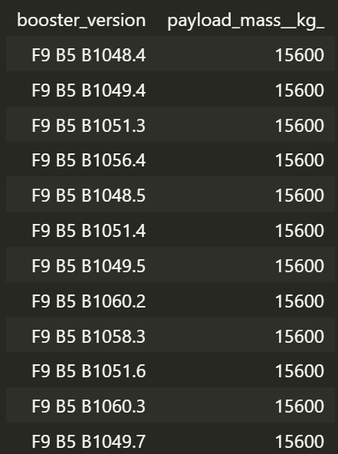
Boosters Carried Maximum Payload
We use MAX() function to select the maximum payload and then use this maximum payload as a subquery in WHERE statement.

Slide 33
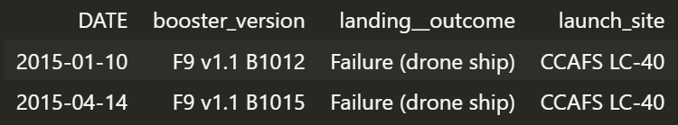
2015 Launch Records
List the failed landing outcomes in drone ship, their booster versions, and launch site names for the year 2015 was retrieved by specifying landing outcome to failure at drone ship in WHERE statement, then using AND operator the filter the year.

Slide 34
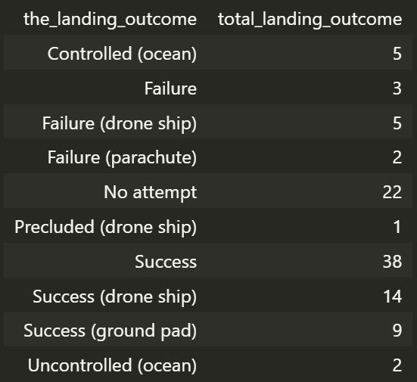
Rank Landing Outcomes Between 2010-06-04 and 2017-03-20
In the SELECT statement, we select the landing outcome and also use the COUNT() function to count the landing outcome, then in WHERE clause we specific the range of dates we want using OR operator, finally in GROUP BY statement we group by landing outcome.

Slide 35

Section 3

Slide 36
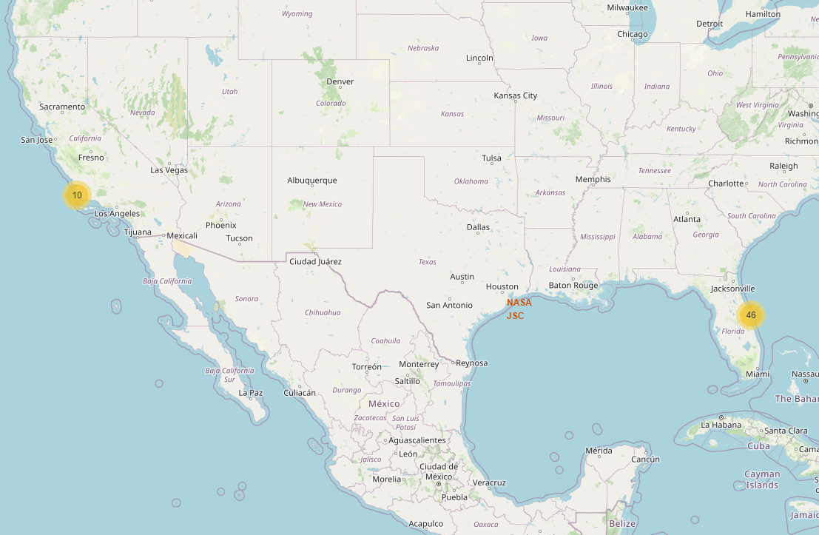
Folium Map: Launch Site Locations
The locations of all the SpaceX launch sites in the US are indicated by the yellow markers.
The launch pads have been situated in a suitable location close to the coast.

Slide 37
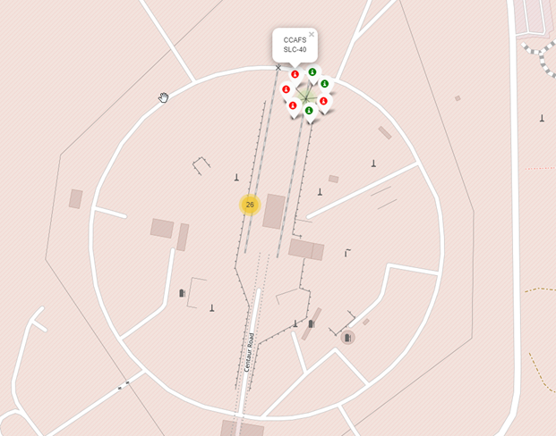
Folium Map: Color-Labeled Launch Outcomes
The launch site will show marker clusters of successful landings (green) or failed landings as we zoom in on a launch location (red).

Slide 38
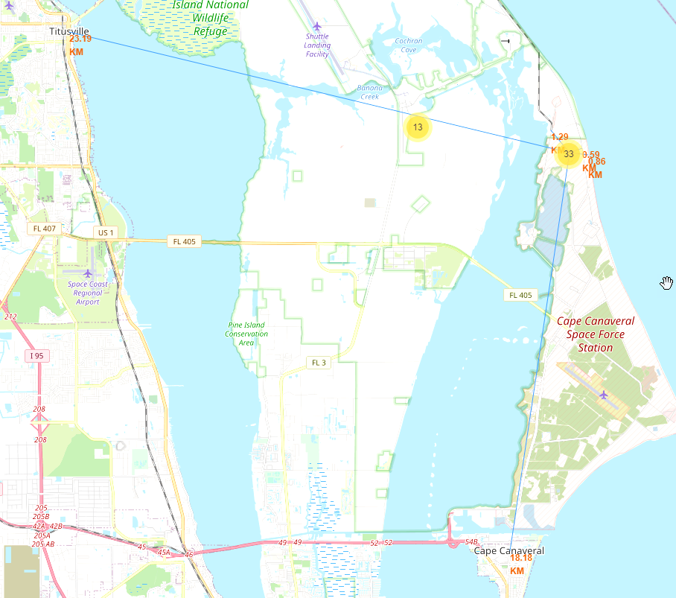
Folium Map: Proximities
The shown in the Folium map we can conclude that the launch site was proximities to the railroad, highway, coastline, and cities.
1.29 from Railroad
0.59 km from Highway
0.86 km from the coastline
18.18 km from Cape Canaveral City
23.19 km from Titusville City

Slide 39

Section 4

Slide 40
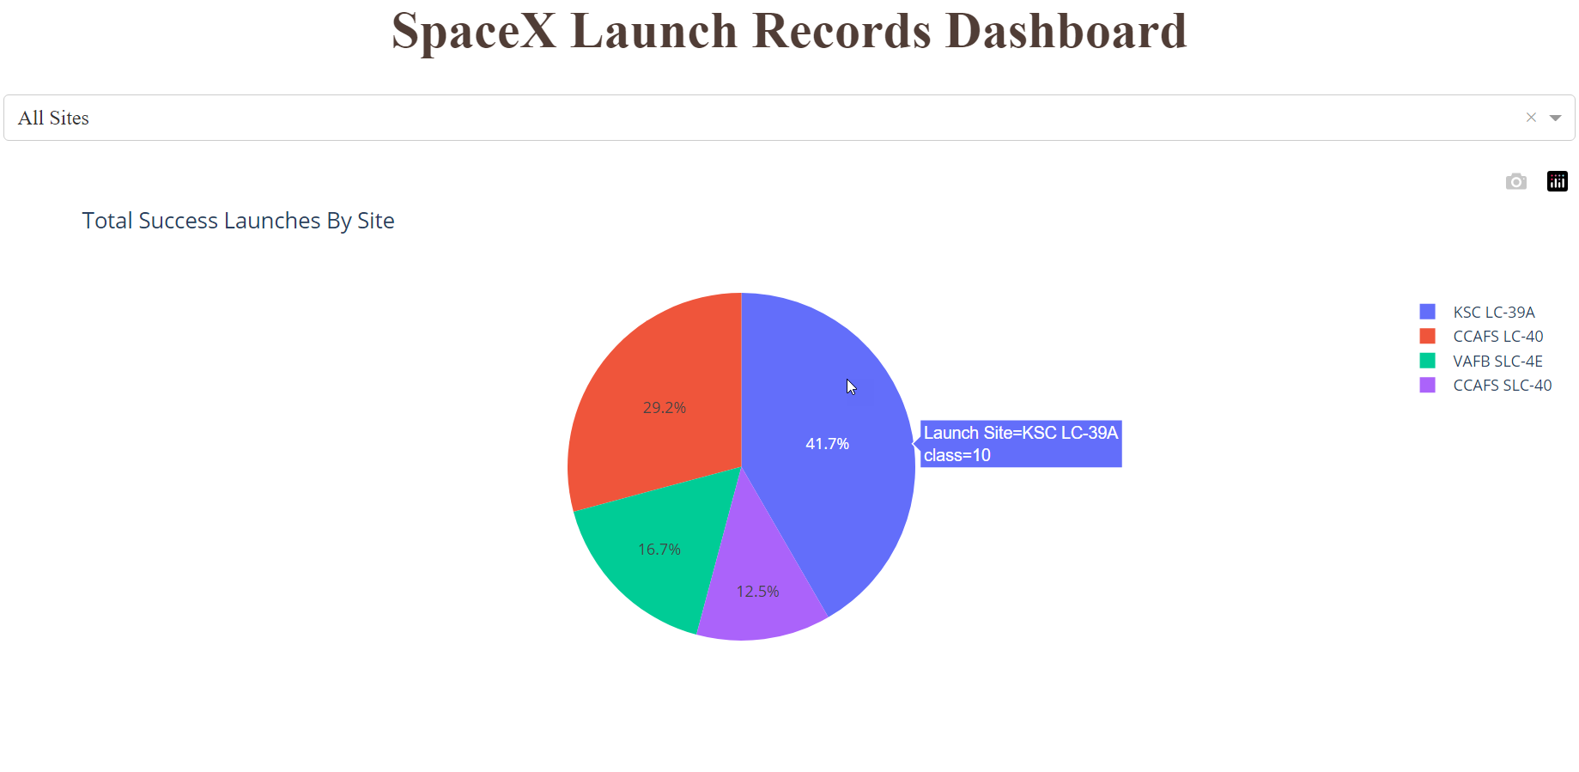
Interactive Dashboard: Pie Chart
The graph show launch mission between launch sites, you can select the launch site to see the success rate and failure rate.

Slide 41
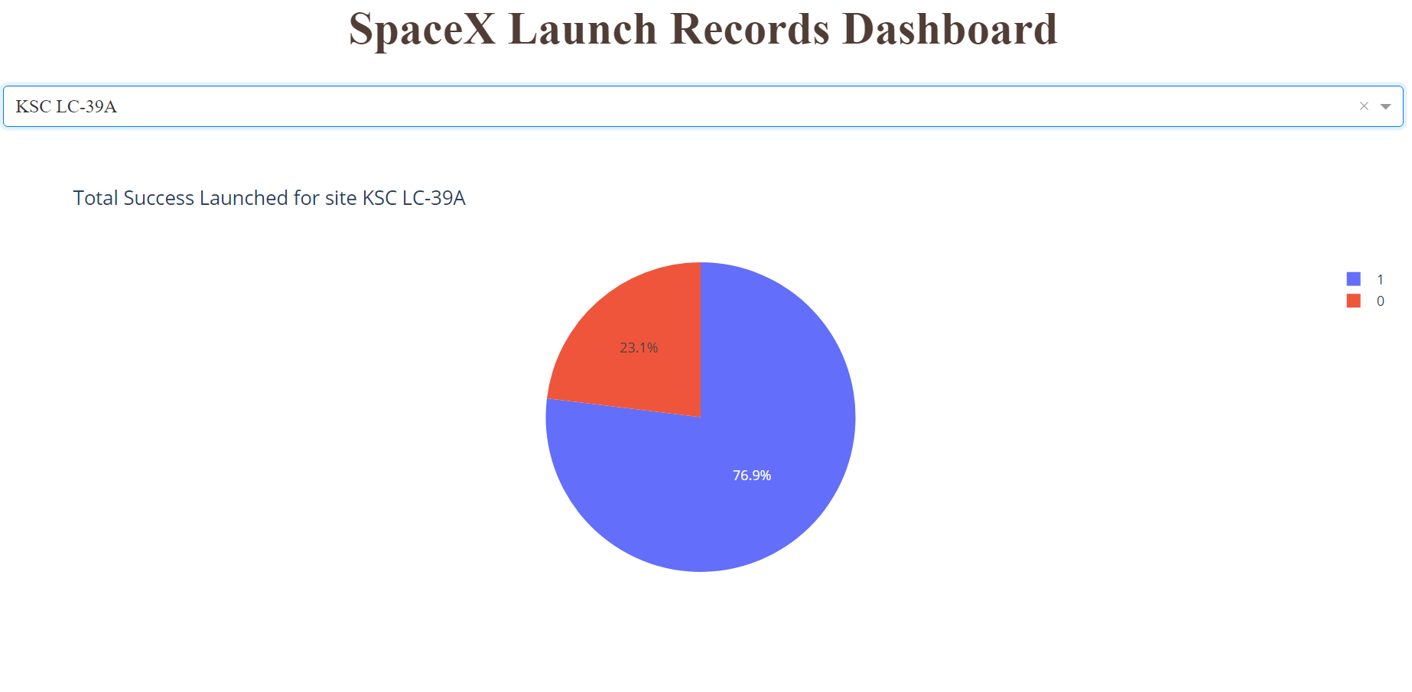
Interactive Dashboard: Pie Chart (KSLC-39A)
The graph shows that KSLC-39A site has the highest success rate of 76.9%

Slide 42
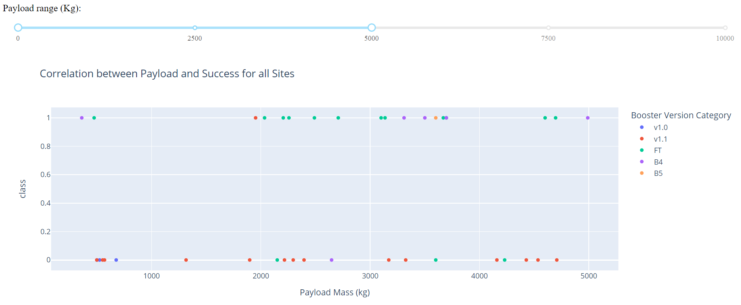
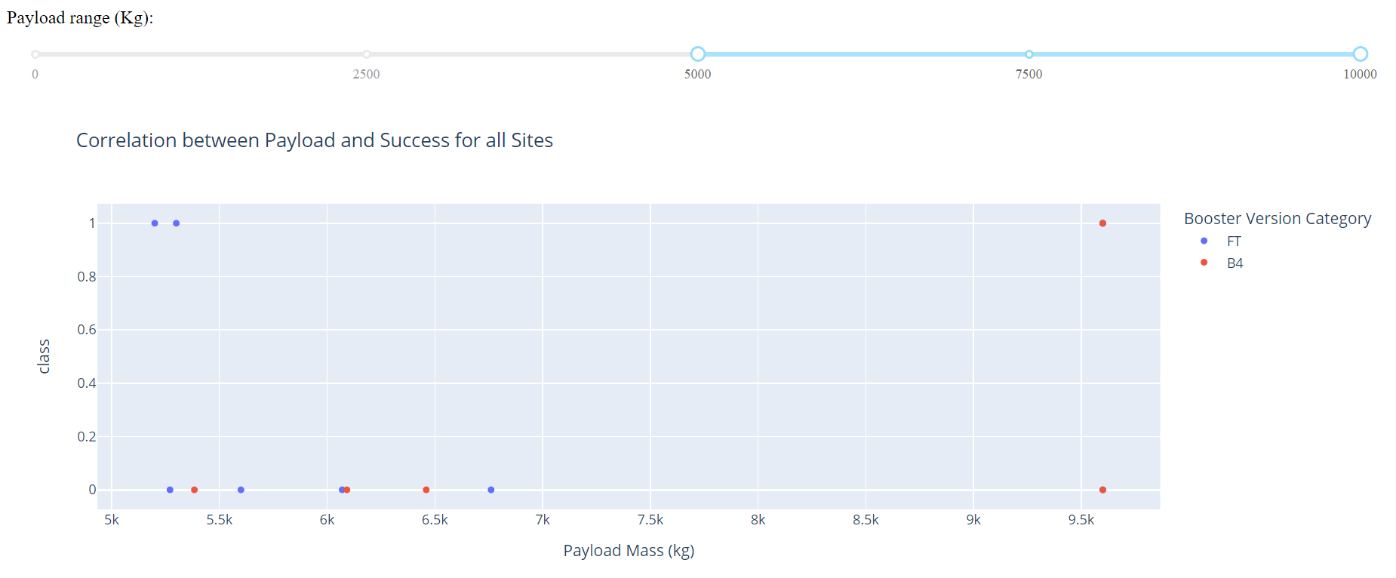
Interactive Dashboard: Payloads vs Launch Outcome
The graph shows the success rate with various payload mass (kg), range from 0 to 5000kg, and from 5000 to 10000kg.
As the payload mass increased, the success rate decreased

Slide 43

Section 5

Slide 44
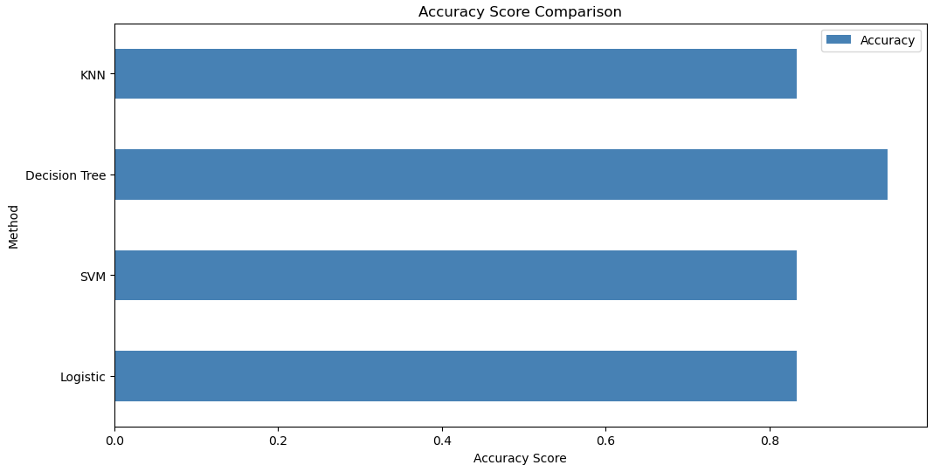
Classification Accuracy
Accuracy Score for each method are as follows:
Logistic regression = 83%
SVM = 83%
Decision Tree = 94%
KNN = 83%
The Decision Tree Model has the highest accuracy score of 94%, while the other model accuracy score is 83%

Slide 45
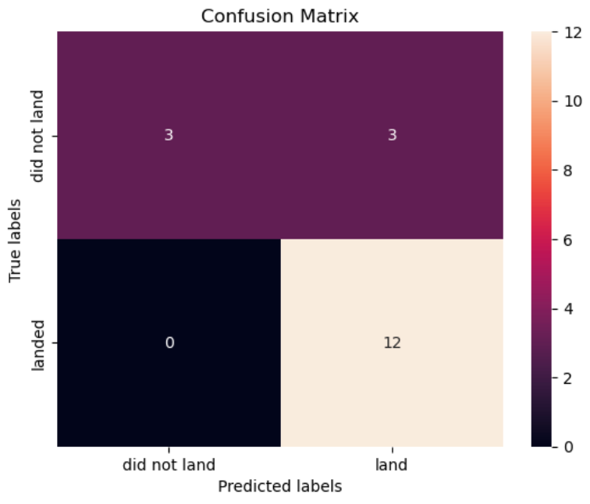
Confusion Matrix
When the True label was a success (True Positive), the model predicted 12 successful landings
When it was a failure, it predicted 3 unsuccessful landings (True Negative).
When the True label was an unsuccessful landing, the algorithm also predicted 3 successful landings (False Positive).
Successful landings were frequently predicted by the model.

Slide 46
Conclusions
The Decision Tree Classifier is the most accurate predictive model for this dataset, having a 94% accuracy rate.
The analysis revealed that as the success rate has increased over time, there is a positive correlation between the number of flights and the success rate.
The launch sites are placed at a safe distance from cities but strategically close to roads and railroads for the transit of people and goods.
Payload mass can be related to success rate since lighter payloads have typically had better results than bigger payloads.
The SSO orbit has a success rate of 100%.

Slide 47
Appendix
GitHub Repository: https://github.com/pkong001/Primary-Repositoty/tree/main/Temp/For-Capstone-Project

Slide 48


